Slide 1
About the MATLAB
MAS109
Seongeun Kim
Notes:
Hello everyone, I am a MATLAB TA, Kim, Seongeun
This is a short opening video for the MATLAB session of the MAS109 course.
I will introduce the overall of the MATLAB, and this takes about 10 minutes.

Slide 2
MATLAB materials
Every Friday, MATLAB materials will be uploaded to the KLMS and MATLAB page.
A 10 – 15 minutes video containing solutions and details of the materials will be uploaded on the next week.
There is a MATLAB page. In there, you can check every materials and progress of the MATLAB session along for each week. https://mireiffe.github.io/mas109_matlab_2021_2/
Notes:
Basically, MATLAB session is based on MATLAB materials uploaded every Friday.
Let’s say a material is uploaded on Friday of week N then the solutions and explanation video will be upload on the Friday of week N+1.
For a week before the video, students are supposed to study on their own.
There is a MATLAB page. In there, you can to grasp all the contents of MATLAB learning.

Slide 3
MATLAB assignments
Some of the material contains assignments. You must upload the result(s) of assignment to ‘assignment page’ of the KLMS. [Late submission WILL NOT be allowed.]
The total score of MATLAB assignments is 6% of the total score for the course.
Notes:
There are submission assignments, like the assignment 0.
The score of your results will be 6% of the total score of this course.
Therefore, let’s make rule. Late submission will not be allowed, except in unavoidable emergencies.

Slide 4
Scoring and claim for assignments
Scoring for each assignment is completed within up to one week from the due date.
You can claim your score for one week.
Notes:
We will be done each scoring of the assignment within one week from the due date.
Then, you can claim your score for one week.

Slide 5
Exams
There will appear MATLAB problem(s) in the midterm and final exams.
The problem(s) will be based on the MATLAB materials of the KLMS and the contents covered in recitation classes.
Notes:
There will appear MATLAB problem(s) in the midterm and final exams and all problems are covered by the MATLAB materials.

Slide 6
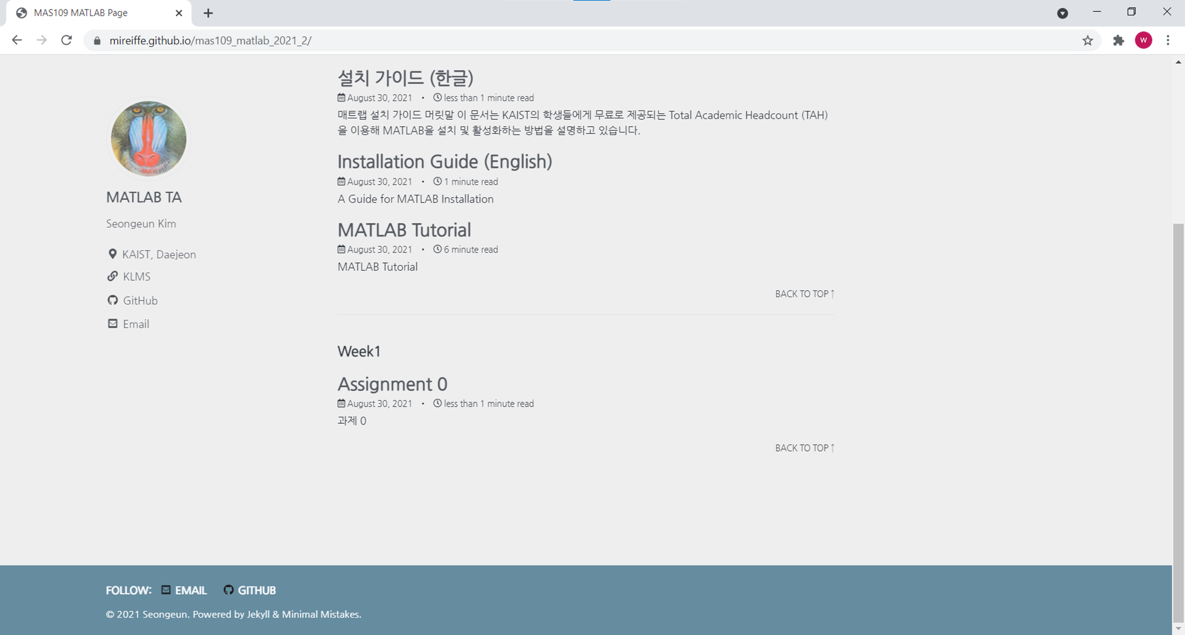
Assignment 0
Notes:
Now, let’s see the assignment 0.
In the matlab page, you can easily find the assignment 0 page.

Slide 7
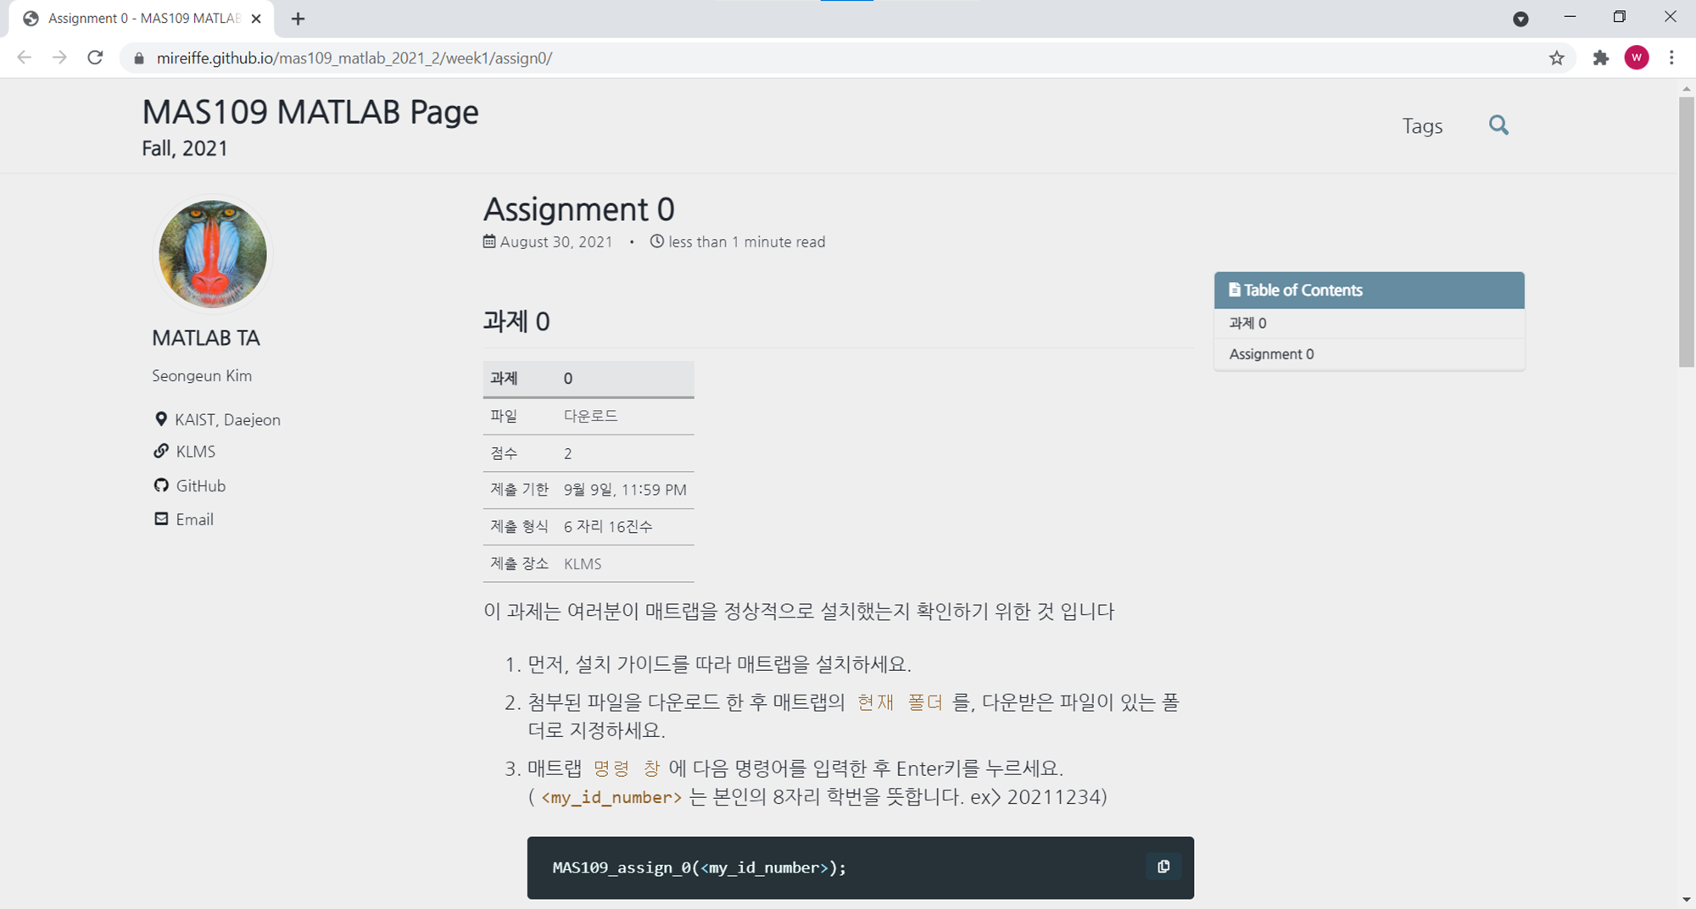
Assignment 0
Notes:
This is submission assignment, so it has 2 points.
You can check due date, submission format and relative KLMS link.

Slide 8
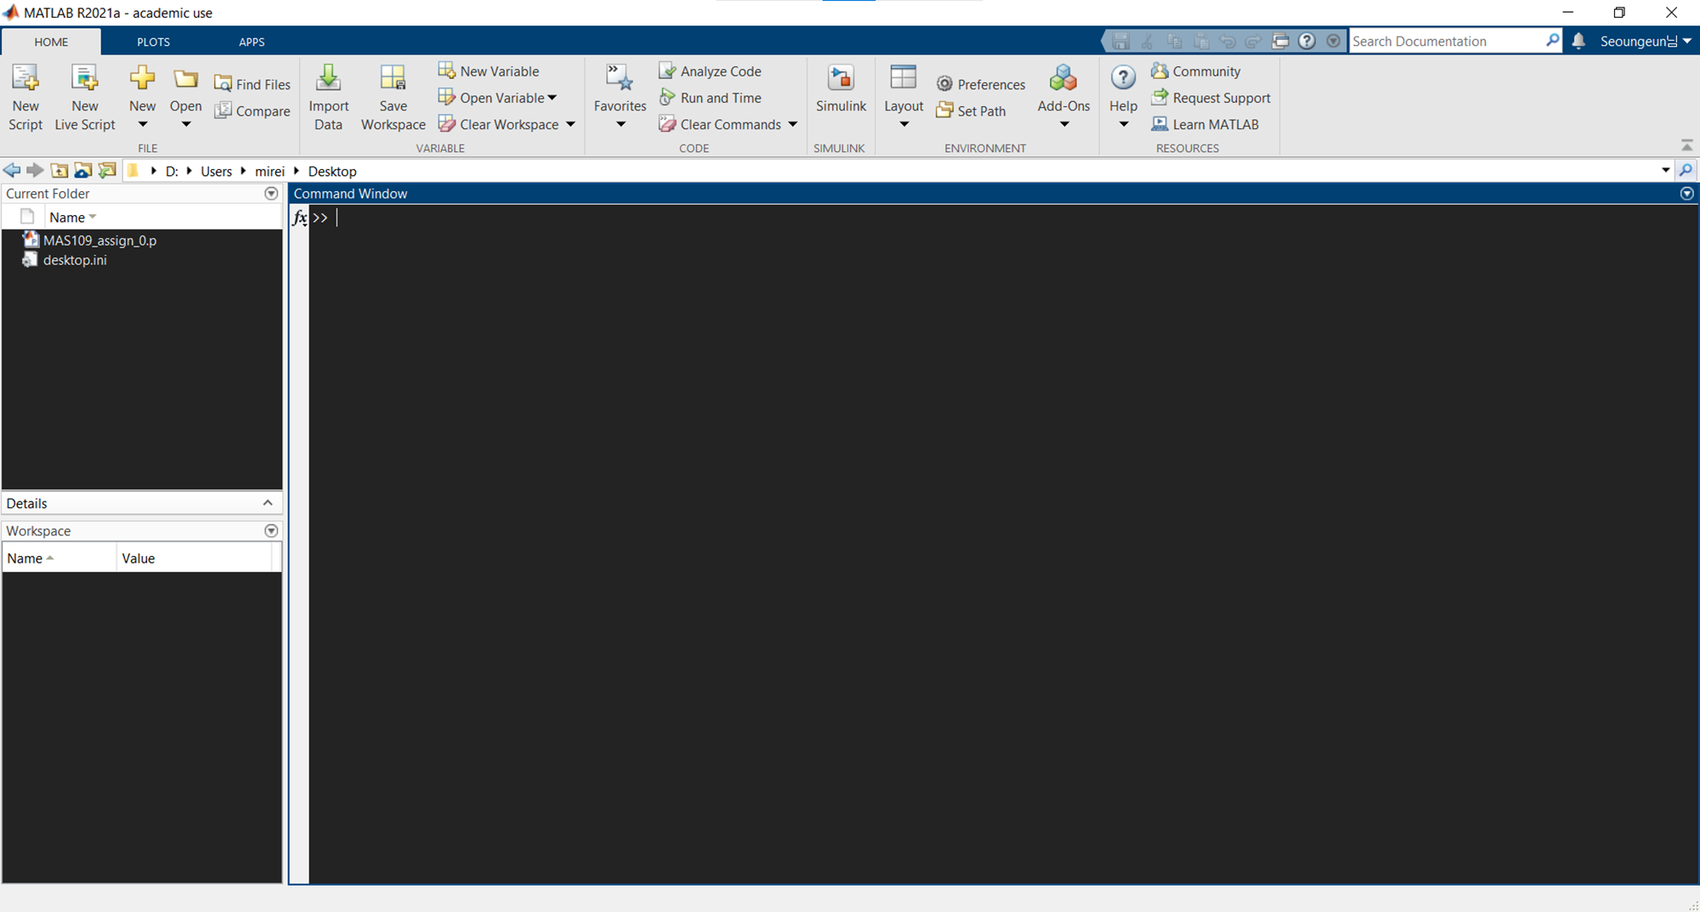
Assignment 0
Notes:
When you download the file MAS109_assign_0.p and locate your Current Folder as an appropriate one, then you can see the file on there.

Slide 9
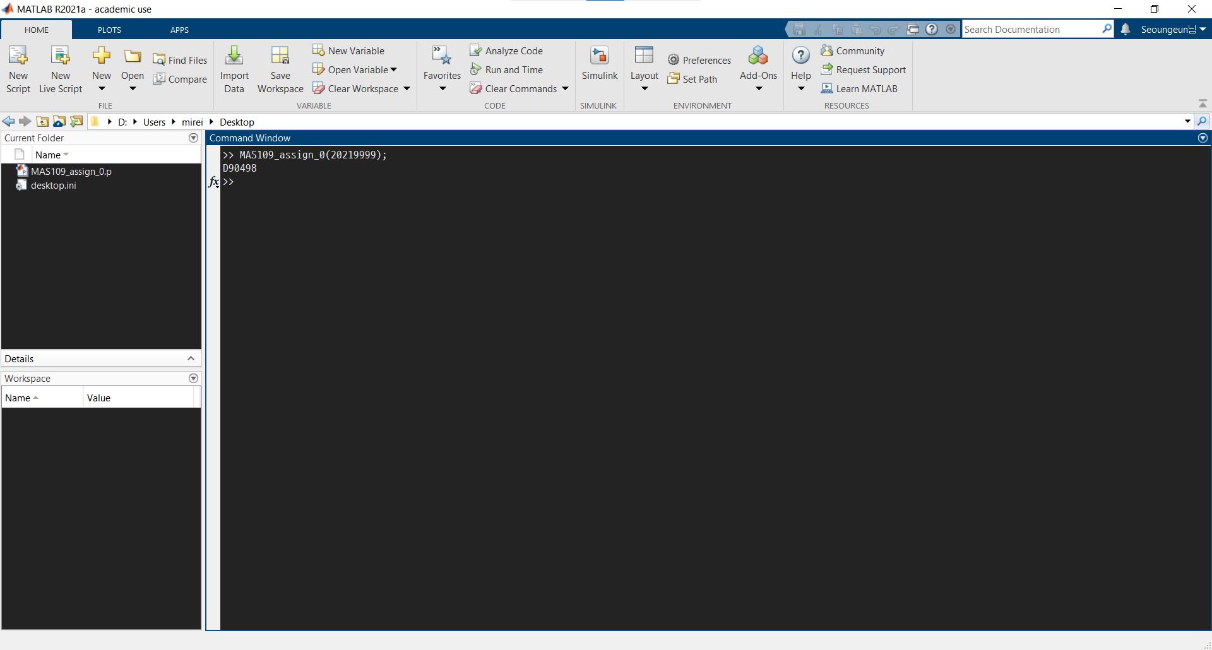
Assignment 0
D90498
Notes:
In this case, by entering the ID number 20219999, I got the hexadecimal number D90498.

Slide 10
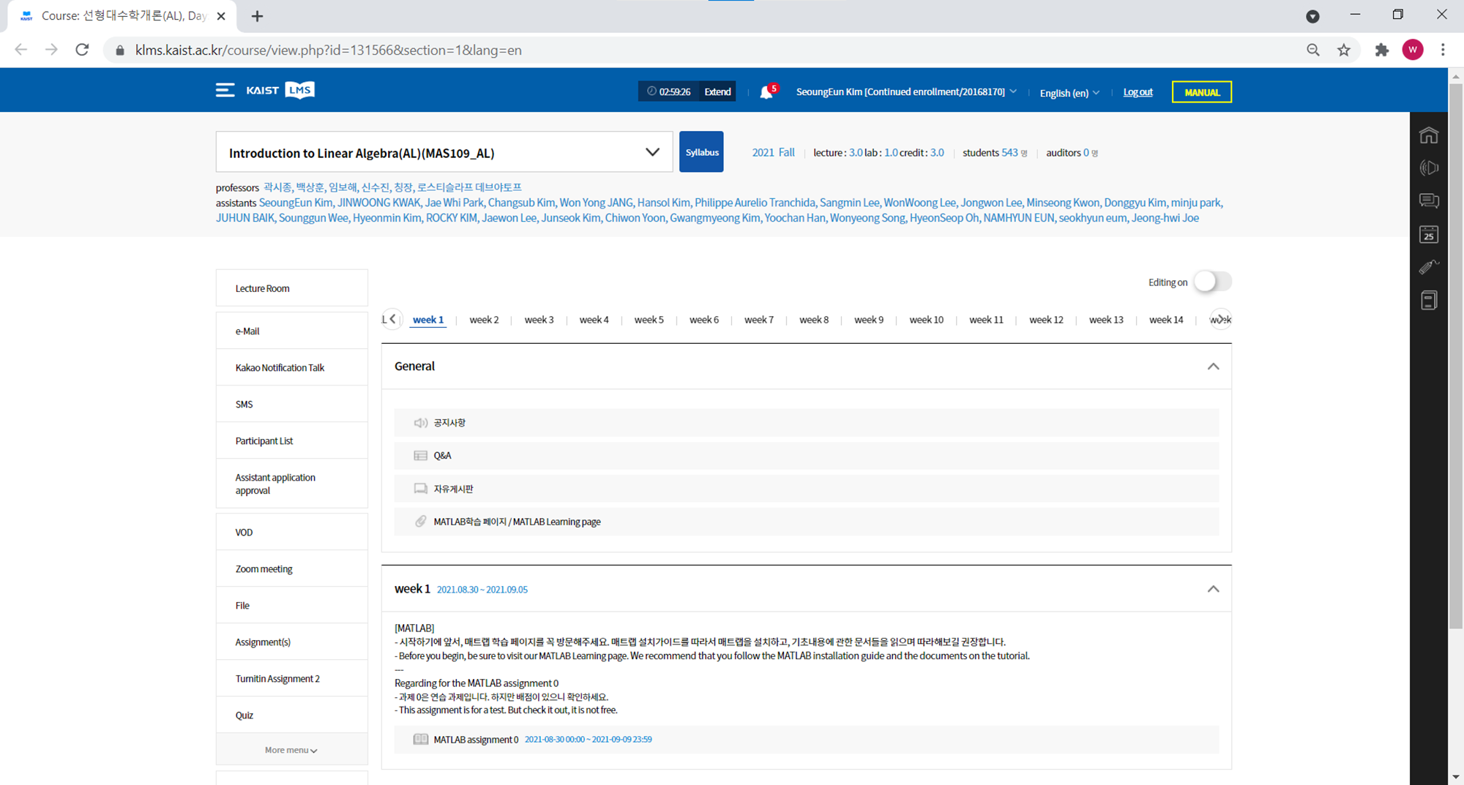
Assignment 0
Notes:
The home workbox is highlighted in red.
Click.

Slide 11
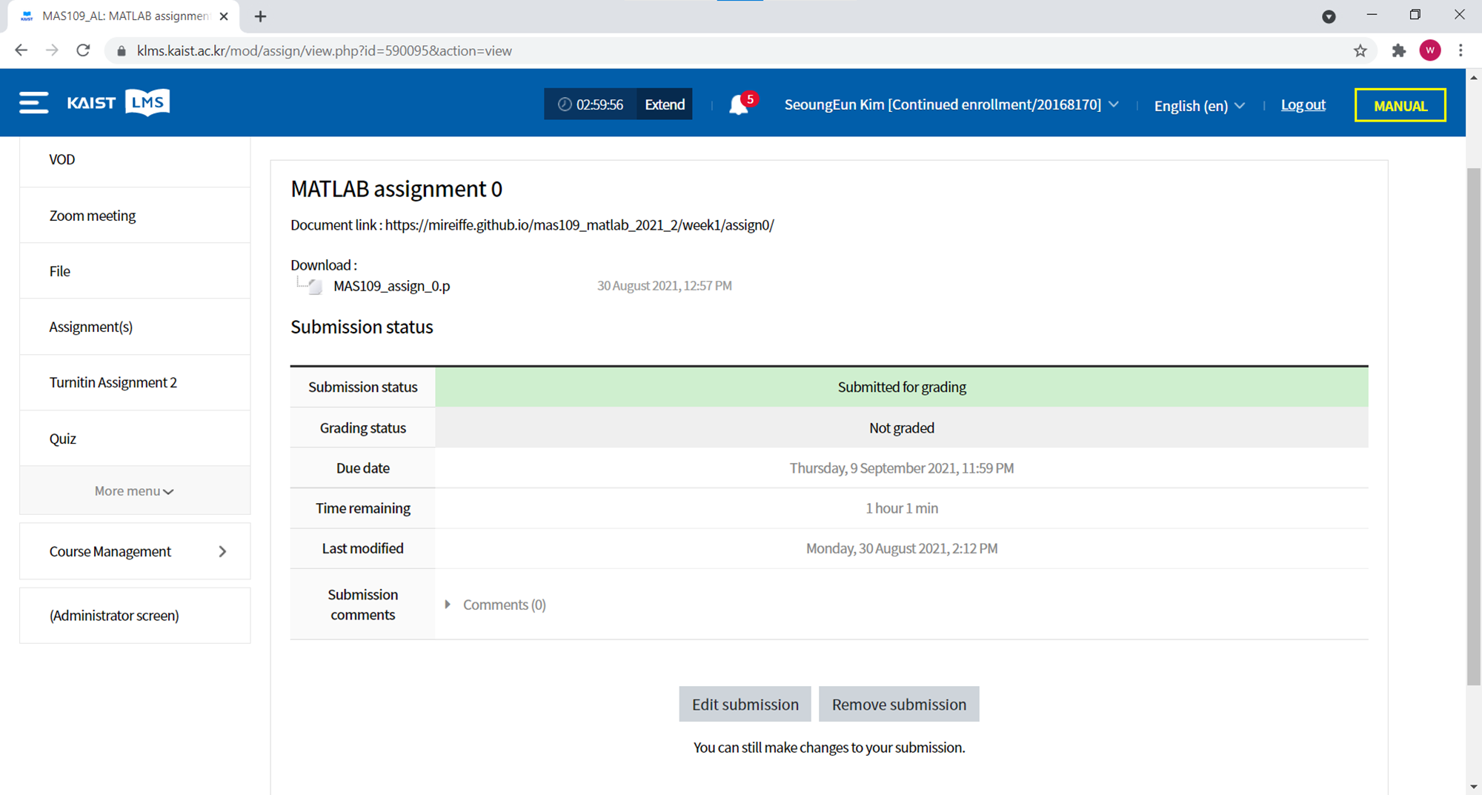
Assignment 0
Notes:
Click the button. If you are the first time, then it is ‘add submission’ button’

Slide 12
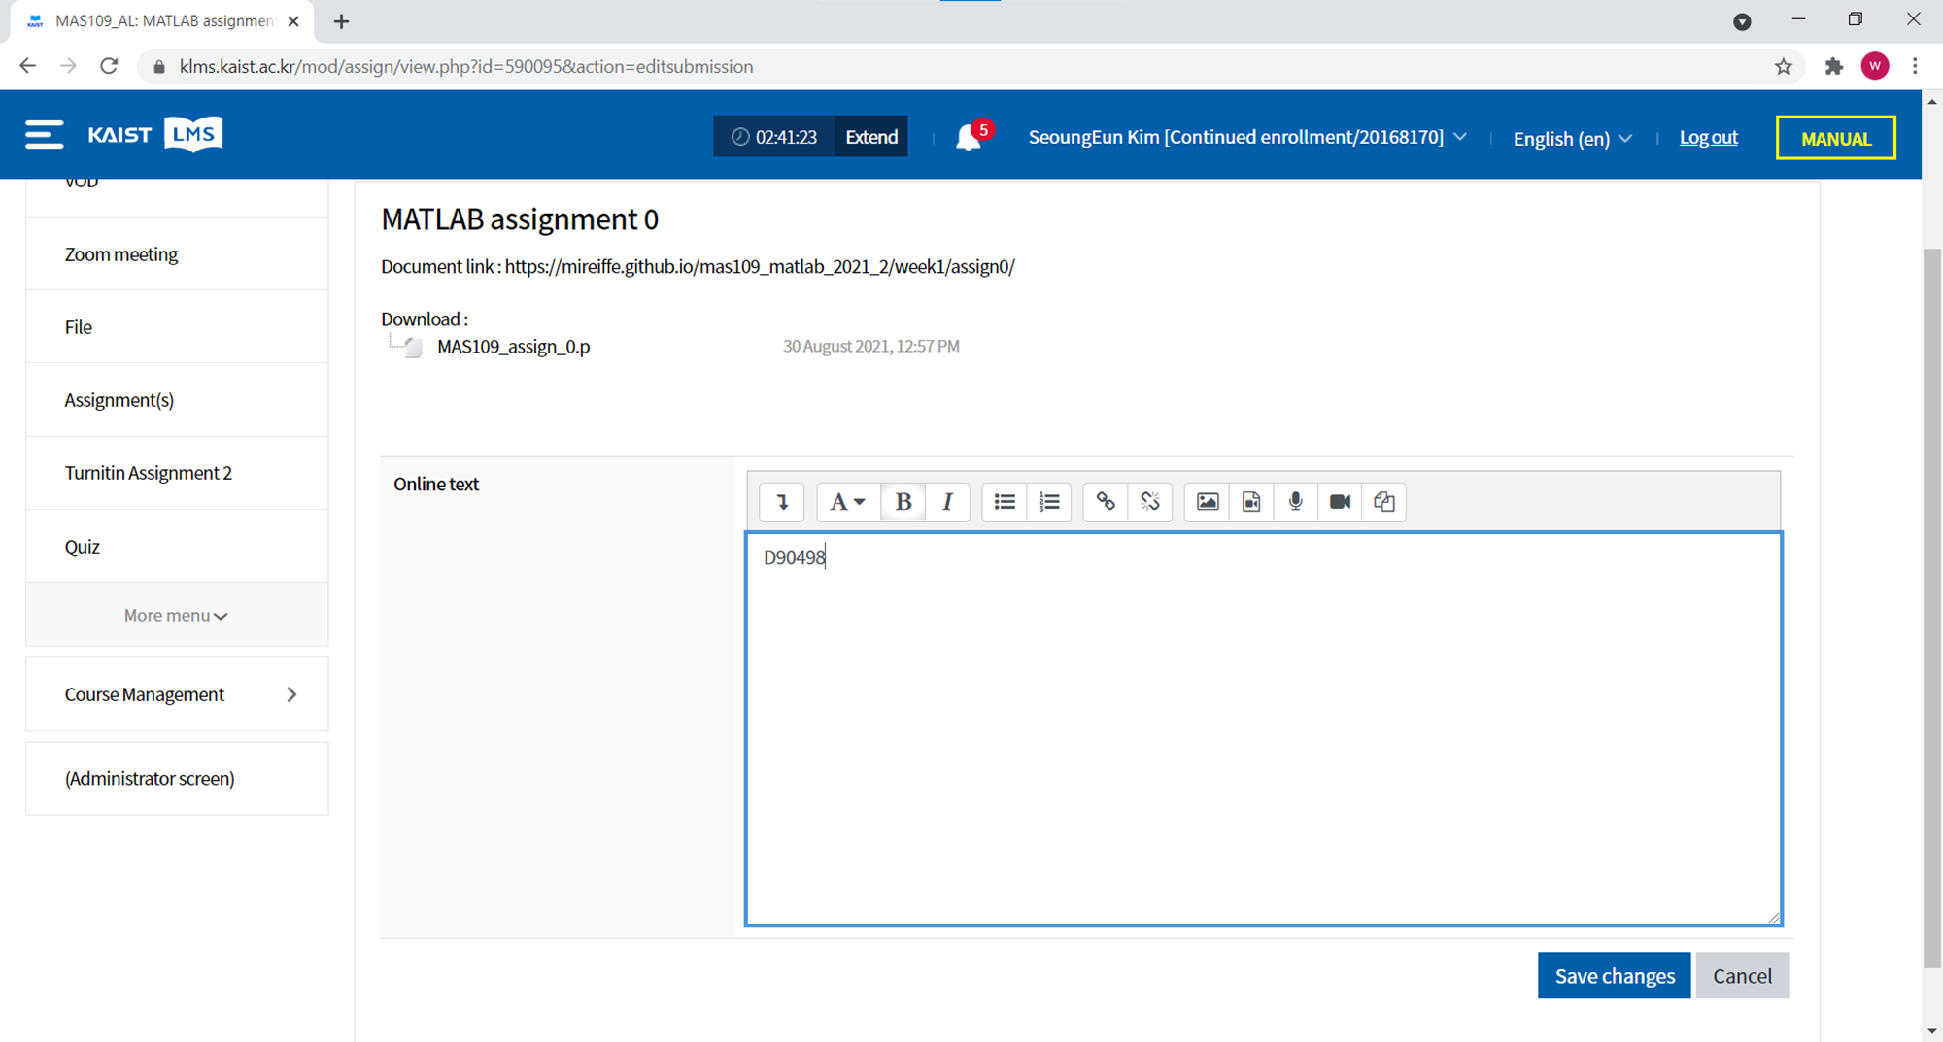
Assignment 0
Notes:
Then write the number and save.

Slide 13
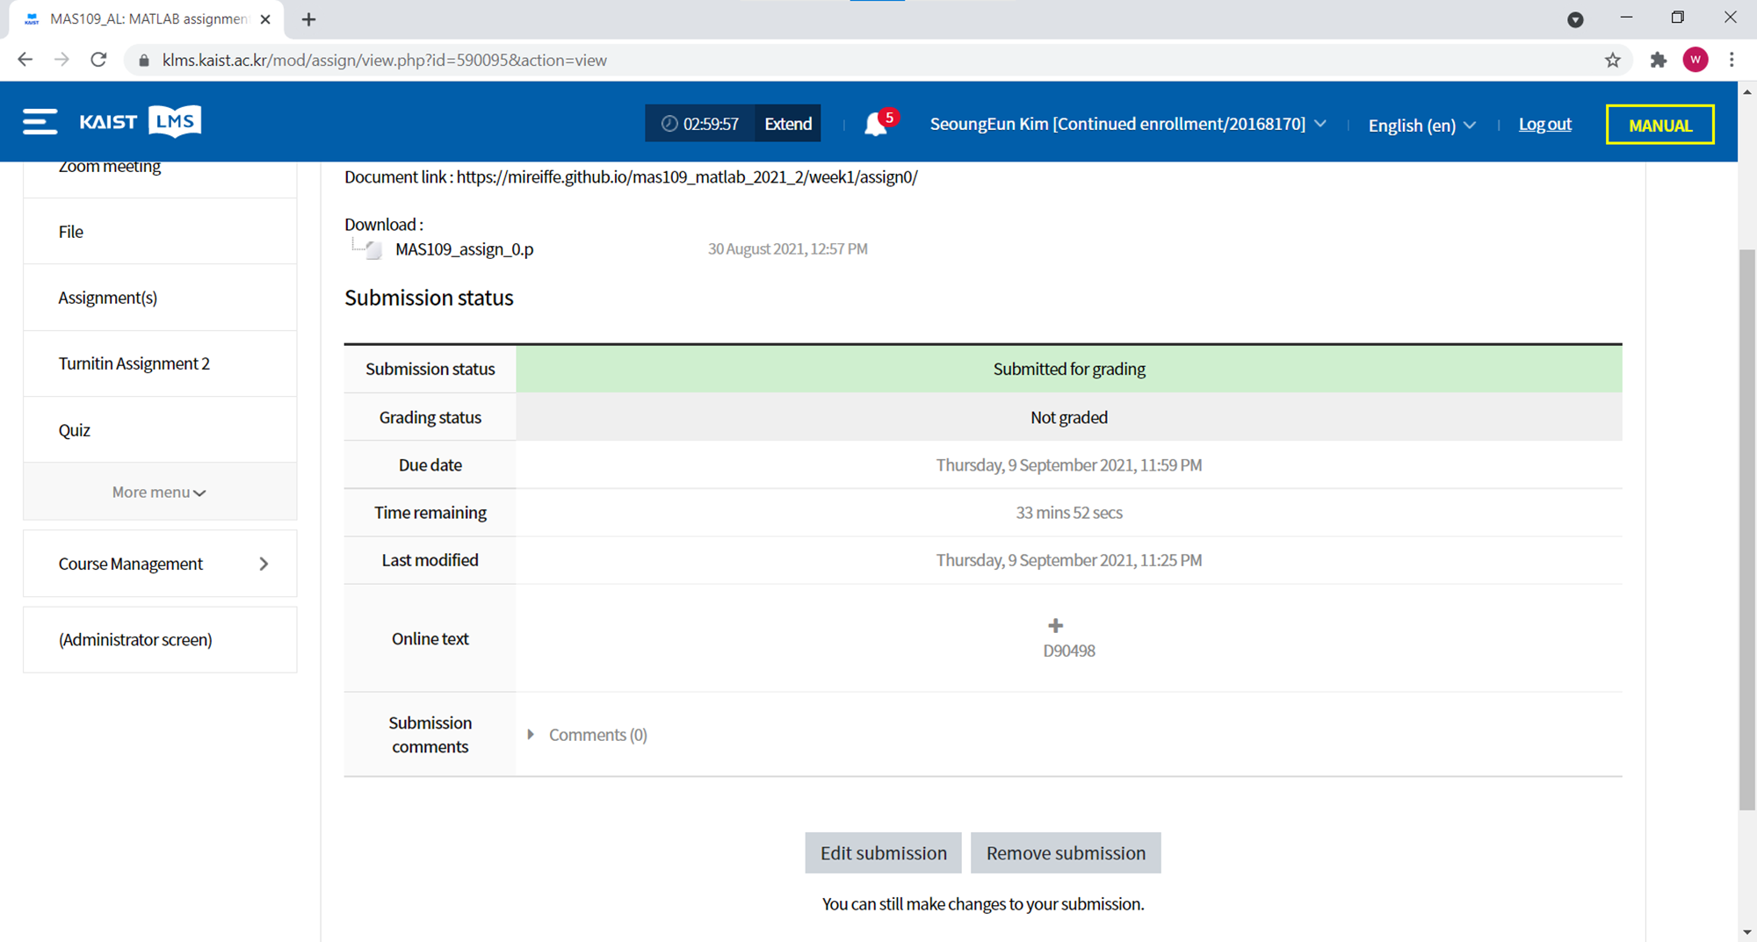
Assignment 0
Notes:
You can check your submission.
This is just a test assignment, so I guess all you did this very well.

Slide 14
What can we do?
RREF
Notes:
Now, let’s briefly see what can we do if we learn the matlab. MATLAB is the most powerful tool for the linear algebra computations.
You did learn the rref of matrix, so you can find rref of the left small 3x3 matrix.
but

Slide 15
What can we do?
RREF
Notes:
But how about this?
I guess, human hardly compute the rref of the left matrix, properly.
Yes, someone can do that, but it must take really long time and many effort.
But matlab can compute that in a flash

Slide 16
What can we do?
RREF
Notes:
How about this? Even this big matrix, matlab can compute its rref in a second.
you can even what is going on?
If we display the matrices using the white and black, which means the lower element the more white and the larger, the more black, then

Slide 17
What can we do?
RREF
Notes:
Then it is shown as this.
So we can find rref of quite big matrix, and this implies we can solve the Ax=b.

Slide 18
What can we do?
Notes:
By learning this course, you will find out that this can be used to extract “most important features of given object” in terms of LINEAR.
So we can find most suitable line or curve for some dateset.

Slide 19
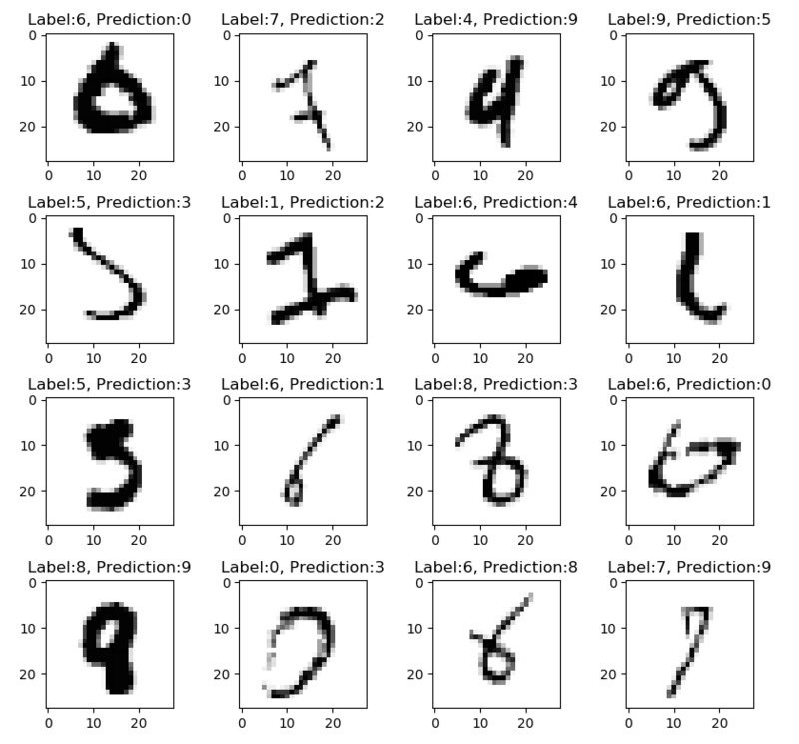

What can we do?
MNIST Dataset
Image reference: https://m.blog.naver.com/rainyday1983/222011720826
Notes:
Or someone make most reasonable predictions in order to the LINEARITY, on this well known hand written number dataset.

Slide 20
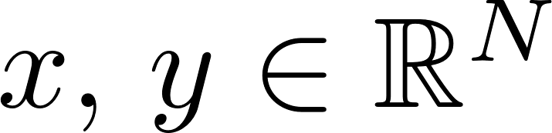
What can we do?
Notes:
On the other hand, we will show how to draw the curves or surfaces.
The important thing is, in the world of computer, every 2D graphs are composed of two vectors x and y.

Slide 21
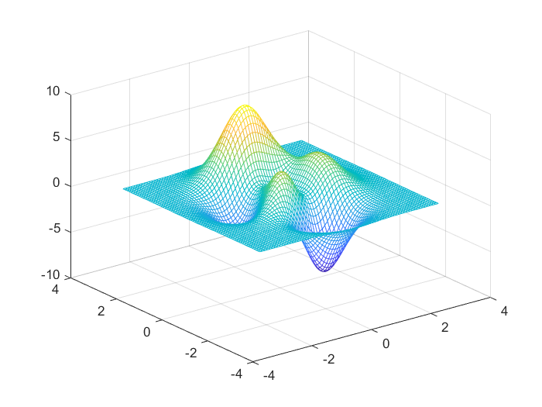
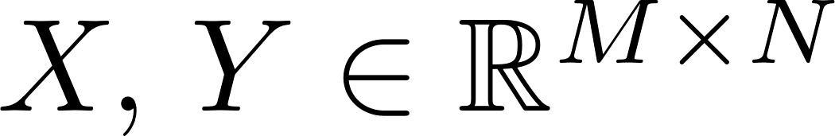
What can we do?
Notes:
Simillary, a 3D surface, is composed of two matrices.
In this section, we will learn some operations and concept necessary to the visualization technique.

Slide 22
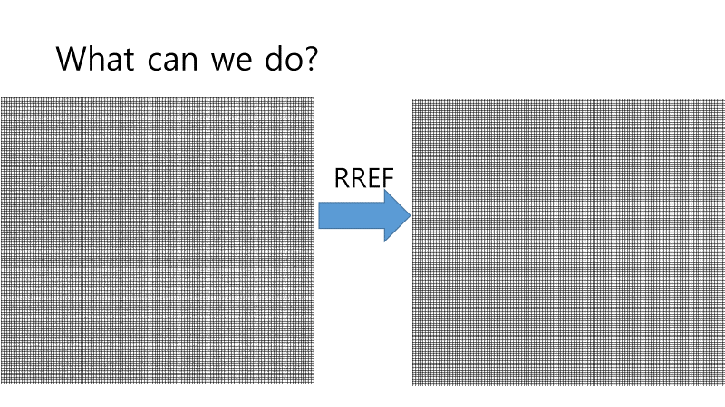
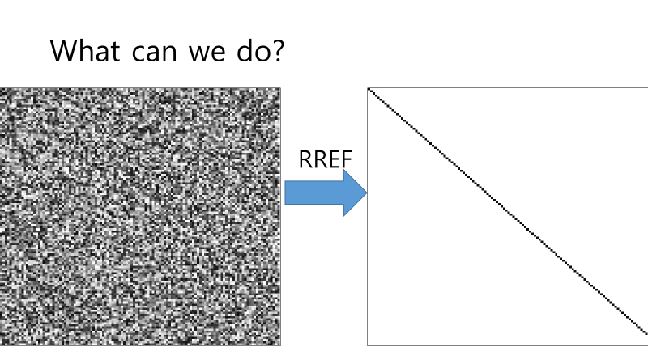
What can we do?
Notes:
We show before that the matrix can be expressed as an image, right?

Slide 23

What can we do?
Notes:
It is definitely true, and actually matrix and image are exactly same, up to just their displaying format.
So, we would deal with LINEAR features of an image and how they construct the image, using tools like eigen for singular value decompositions.

Slide 24
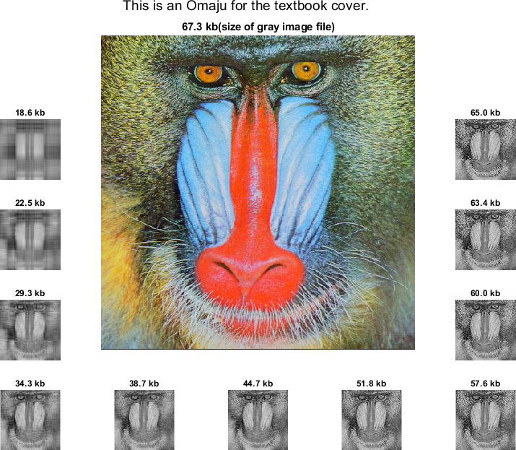
What can we do?
Notes:
In that stage, we will get how the cover of our textbook is related with linear algebra.

Slide 25
MATLAB TA
김성은 (Kim, Seongeun) E-mail : mireiffe@kaist.ac.kr
* We also check the comments section of our MATLAB pages.
Notes:
Okay now I am done.
Thank you for listening, and if you have question, then please fell free to send an email.

